Slide 1
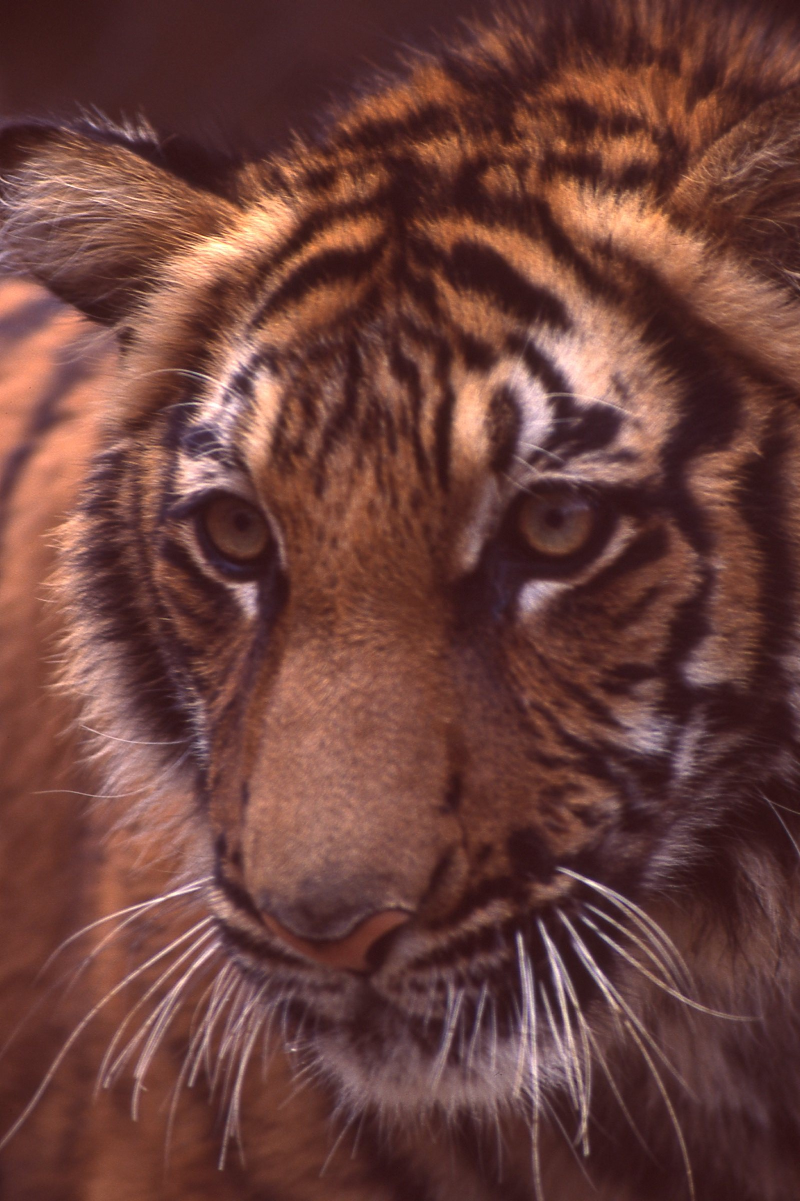

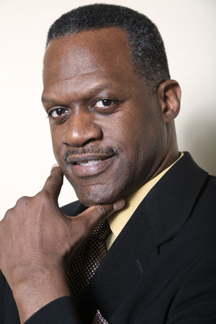
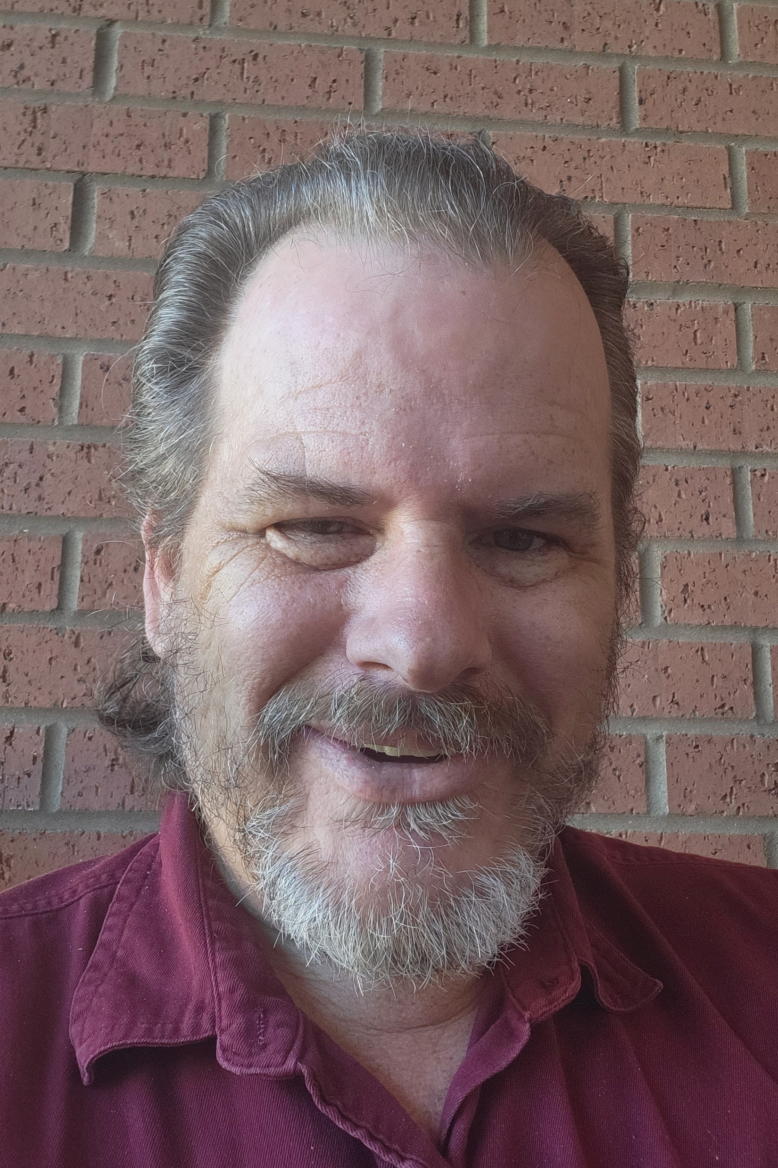
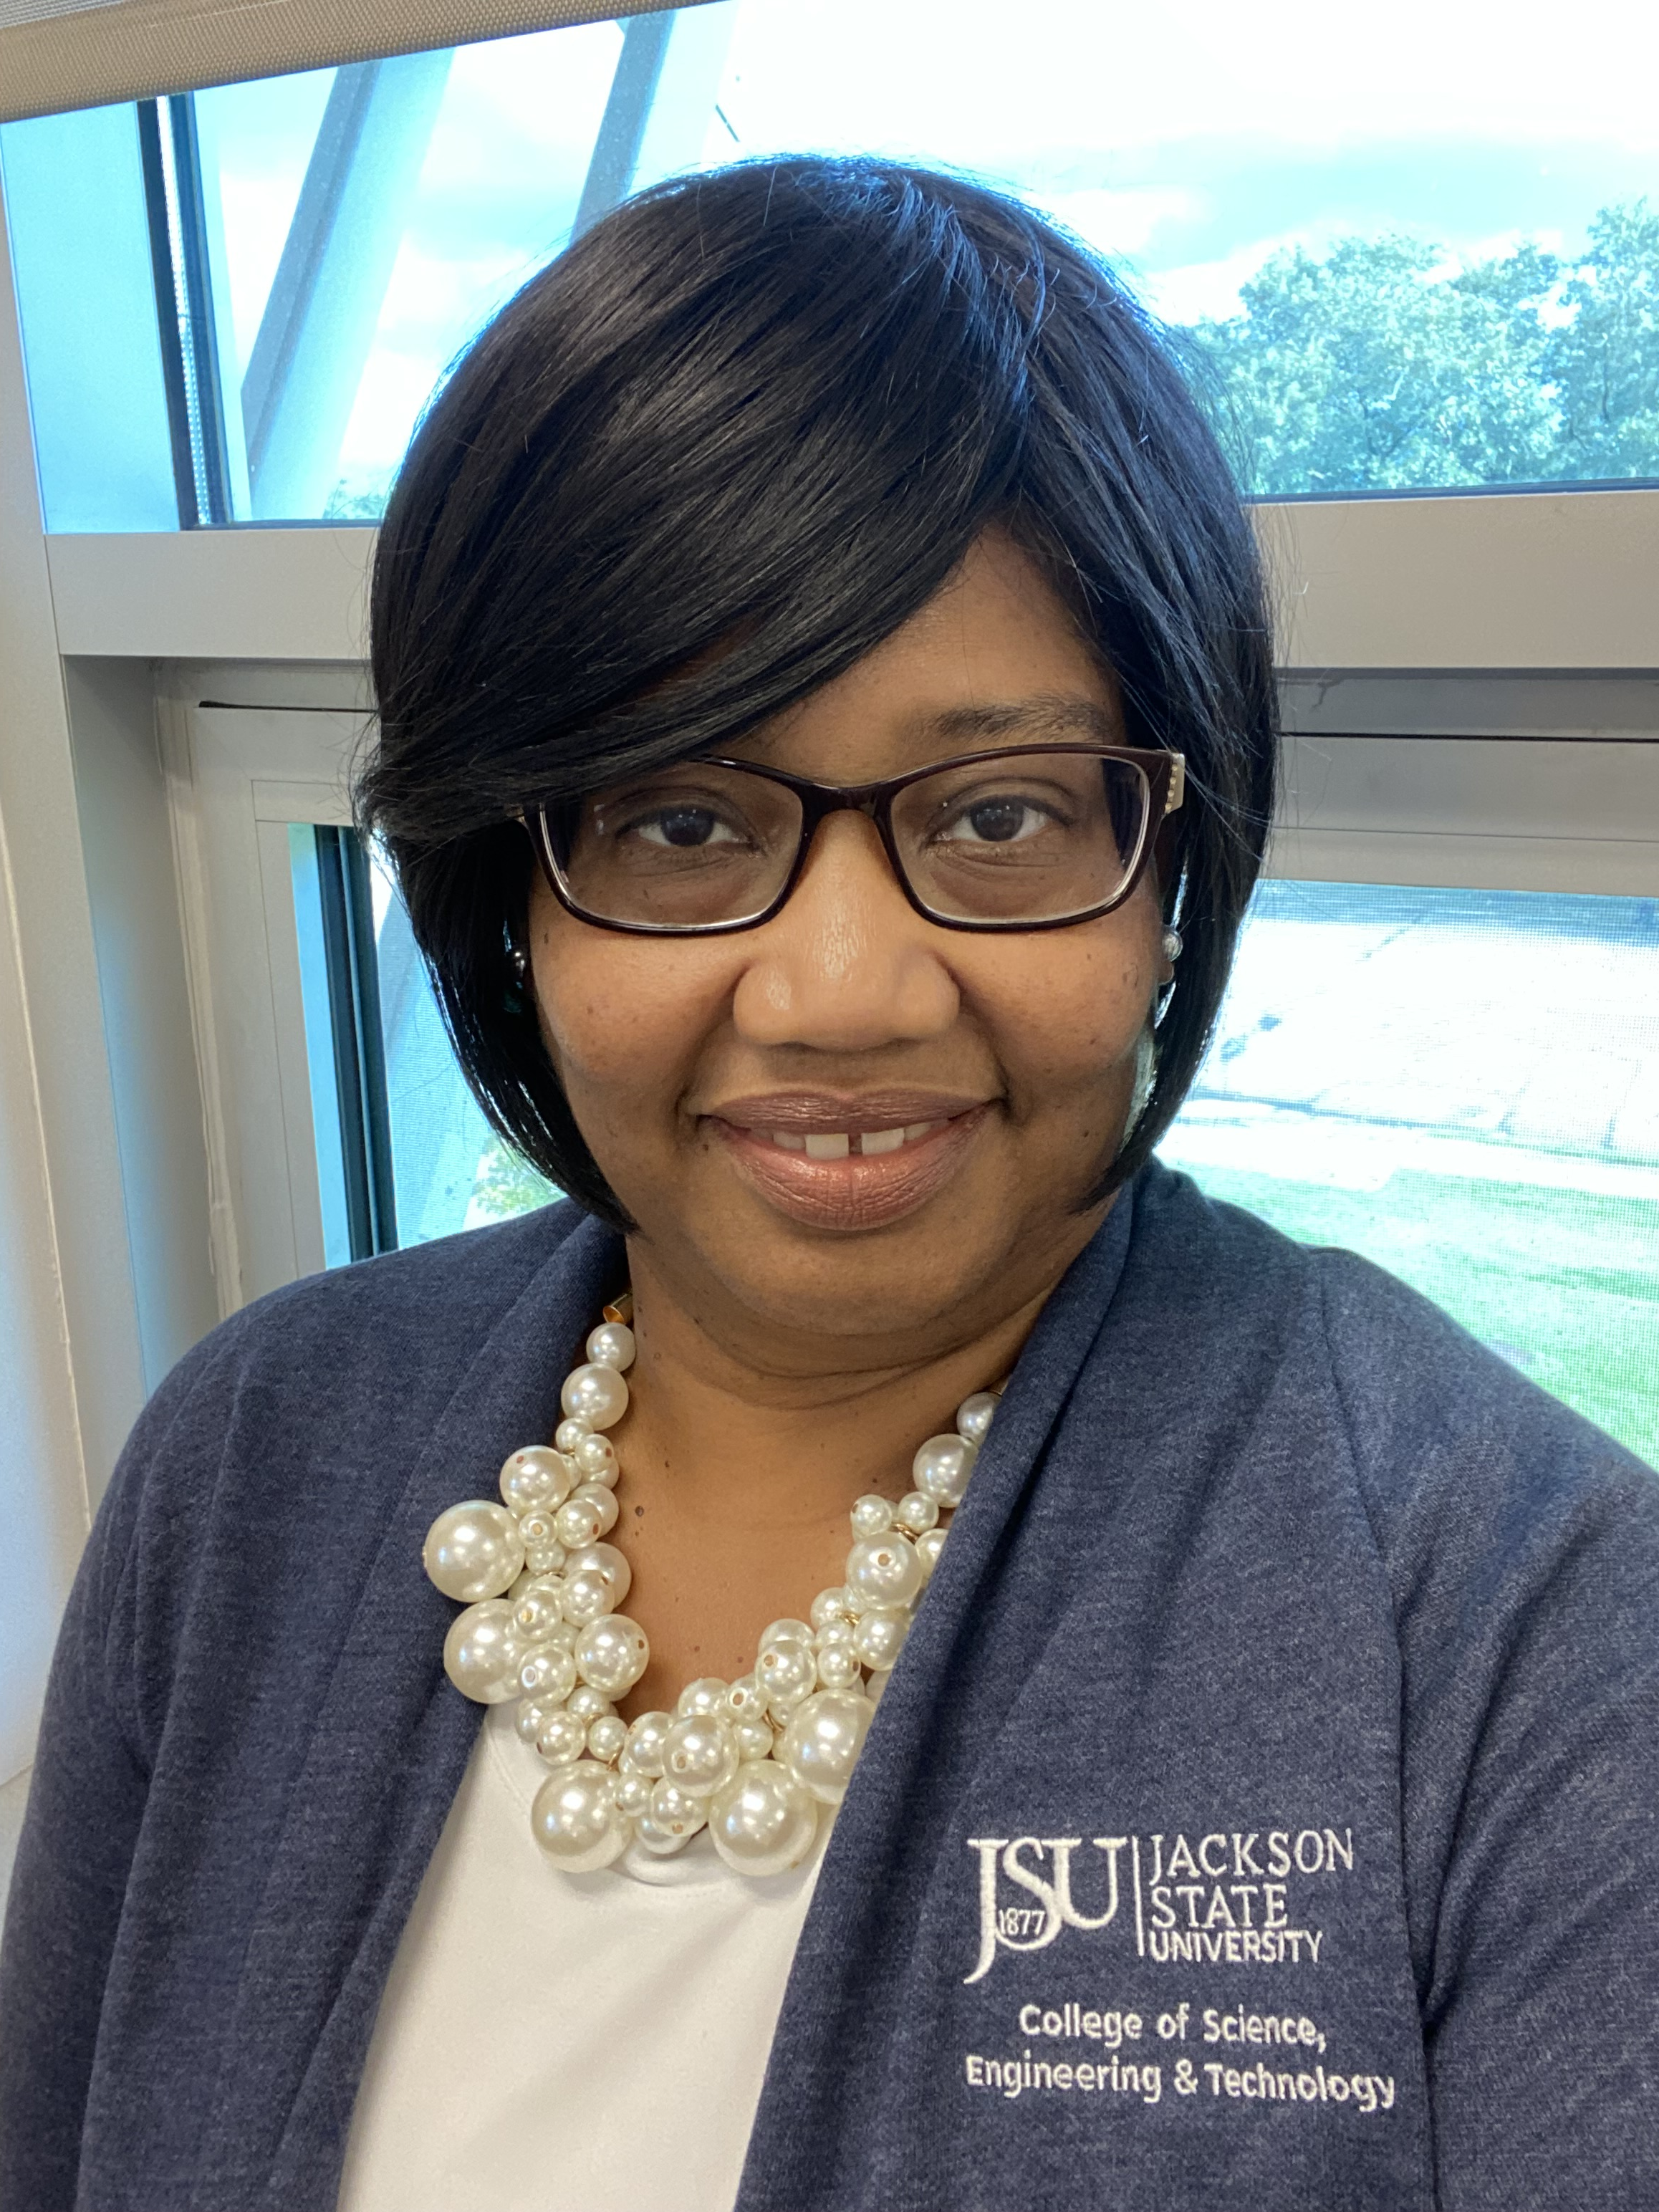
Team Tech Tigers
Alfred Watkins
Department Chair
Computer Science Department
BS Morehouse College
BEE & PhD Georgia Institute of Technology
Jacqueline Jackson
Interim Chair
Department of Electrical & Computer Engineering and Computer Science
Jackson State University
BS Computer Science Jackson State University
MS & PhD Computer Science – Auburn University
Andrew Overton
Adjunct Professor
Department of Electrical & Computer Engineering and Computer Science
Jackson State University
BS & MS Computer Science – Jackson State University
Team Song: Weird Science by Oingo Boingo

Slide 2
Target Course & Goals
Target Course:
ECE 101 – Introduction to Electrical & Computer Engineering
Goals:
- Expand the Introduction to Computers to include an introduction to High Performance Computing
- Introduce students to cloud services including GitHub and AWS
- Expand students’ understanding of the need for HPC professionals

